Slide 1



XDW approach presented to the Cardiology Tech Cmte
Mauro Zanardini, Elena Vio (Arsenàl.IT)
December 16th, 2015

Slide 2
What is XDW ? (1/2)
Content Profile published in the ITI TF (moved in final text in 2015);
Defines the schema for the creation of a document (the Workflow Document)
Schema based on:
CDA R.2 (HL7)
WS-HumanTask (OASIS)
IHE extension
Does not define any specific workflow: it would be generic, to be able to support a wide variety of clinical/administrative workflows

Slide 3
What is XDW ? (2/2)
Relies on a Document Sharing Infrastructure (e.g XDS.b , XCA, XDR , …)
Can inherit the whole set of profiles that “regulates” Document Sharing (Security, Notification, …)

Slide 4
Why XDW Approach?
The Cross-Enterprise Document Workflow (XDW) profile enables participants in a multi-organizational environment to manage and track the tasks related to patient-centric workflows:
No central controller (orchestrator of the workflow)
No central scheduler
Decisions are made by the “edges” (each actor involved can influence the evolution of the workflow)
Information related to the workflow, and document produced have to be shared between actors involved (Reports, Images, … )
Notes:
MORE ABSTRACT…

Slide 5
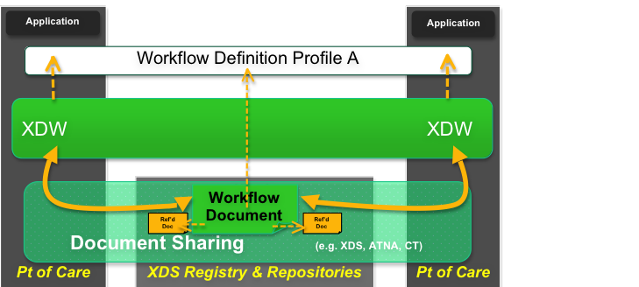
XDW Workflow management infrastructure
-How to share documents
-How to notify documents update
-Security/privacy etc…
Document Sharing Infrastructure

Slide 6
XDW Workflow management infrastructure
-How update the Workflow Document
-Rules for documents linking (input/output)
XDW Workflow Management Infrastructure

Slide 7
XDW Workflow management infrastructure
-actors
-tasks
-rules for task transitions
Workflow Definition

Slide 8
Workflow Definition profile
A WD is a profile that describes how to use XDW in a specific context (such as Hearth Team activation/management process…)
What can be profiled by a WD ?
Actors involved in a specific workflow
Tasks that need to be accomplished (and their sub-status)
Rules for task evolution (and the meaning of each sub-status within a task)
Documents/Data Shared within the workflow
XDS metadata binding for specific needs
Notifications Creation/Delivery requirements (as a DSUB grouping)

Slide 9
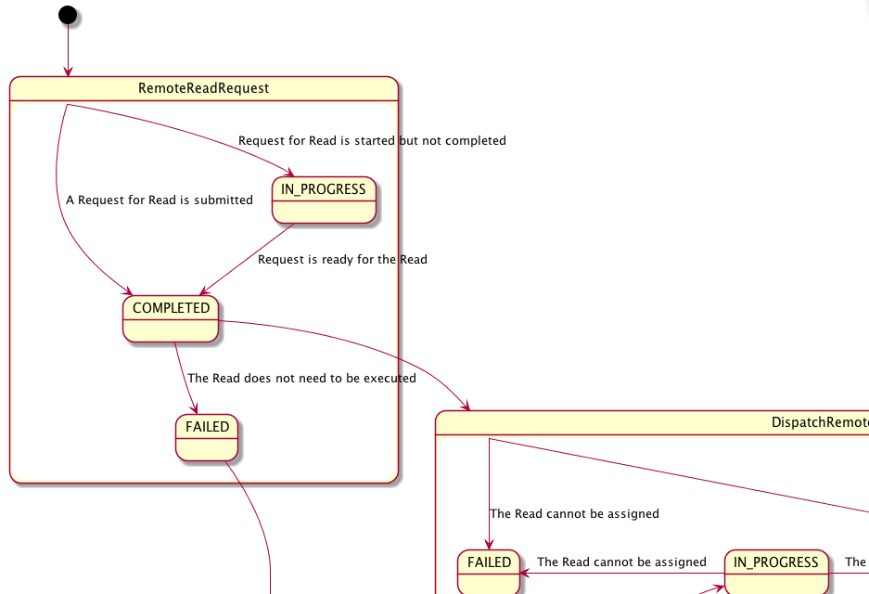
How do we represent an XDW Workflow?
UML activity diagram to describe all the possible evolutions of the workflow

Slide 10
What we want to do with the XCHT:
Other WD profiles:
profiled patient-driven Workflows that were “governed” by the patient that is an active participant of the Wf: An healthcare provider is involved in a workflow because the patient moves to it.
A participant identifies another participant to involve in the process (Targeted Notification)
A participant assigns a task to another participant (Task assignment)
Can be done using DSUB functionalities and XDS Binding

Slide 11
Participant Enrollment:
Each system that can participate to a workflow SHALL create a subscription for submissionSet target to itself
A participant that want to enroll another participant SHALL submit the Workflow Document identifying as intended Recipient the target participant
Task Assignment:
A participant can assign a task to another participant
This is done creating a task in status READY (the activity is assigned to a participant), and identifying the <potentialOwners> of the task as the intended owner.
Only the intended owner can operate on the assigned task.

Slide 12
An Example: eReferral workflow actors
Any participant that affects the evolution of the process:
GP: acts as Referral Requester, starting the process with a referral request
HCP: acts as Referral Scheduler, scheduling the visit
Specialist: acts as Referral Performer, starting and completing the visit
Any actor involved: acts as Workflow Monitor, managing exception situations

Slide 13
eReferral workflow Tasks
Any complex action performed by an enterprise:
Referral Requested: a type of task that tracks the request for a referral process.
Referral Scheduled: task type that tracks the take in charge of the eReferral document by an HCP.
Referral Referred: task type that tracks the progress and the completion of the referral.

Slide 14
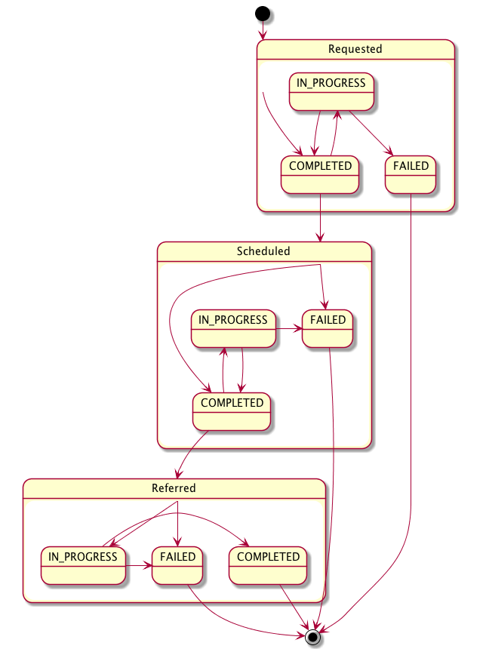
eReferral process evolution
Identify events that affect the evolution of the process as triggers:
Completion of Request (Task “Referral Requested” in status COMPLETED)
Completion of Scheduling (Task “Referral Scheduled” in status COMPLETED)
Start of the consultation (Task “Referral Referred” in status IN_PROGRESS)
Completion of the Referral (Task “Referral Referred” in status COMPLETED)

Slide 15
Documents produced
Any clinical or administrative information conveyed between actors involved:
eReferral: document that describe the referral requested and probably the reason for the request
Clinical Input: clinical information tracked to justify the request
Exception Report: document produced in case of exception situation
Reminder Note: document that tracks information reated to the scheduling of the visit
Clinical Report of the visit: document that tracks results of the specialist's consultation

Slide 16

Referral Request
The GP’s software, as Referral Requester, produces the eReferral Document and the related Workflow Document characterized by:
WorkflowDefinitionReference= 1.3.6.1.4.1.19376.1.5.3.1.5.1
WorkflowStatus=OPEN
Only one task “Referral Referred” in status COMPLETED
This task has the “eReferral” attachment as output.
Workflow Document
Ver.1
APPROVED
eReferral document
XDS infrastructure
Documents produced are submitted to the XDS Infrastructure
The eReferral document is now available, along with its related status tracked by the Workflow Document, to all the Document Consumer & Referral Scheduler actors.

Slide 17
Referral Scheduling
The HIS, as Referral Scheduler, checks the status of the eReferral document consuming the Workflow Document related. The visit has not been scheduled yet (last task is “Referral Requested” in status COMPLETED). The Referral Scheduler took in charge the process updating the Workflow Document:
Adding a new task “Referral Scheduled” in status COMPLETED
With the “eReferral” document as input of the task
Workflow Document
Ver.2
APPROVED
eReferral document
Workflow Document
Ver.1
DEPRECATED
The eReferral Document is now available for the Specialist that has to perform the visit.
The visit can be cleared by the HCP, changing the status of the task “Referral Scheduled”:
IN_PROGRESS: needing to schedule again the visit (same HCP)
FAILED: eReferral is released by the HCP
17
Notes:
Anoher possibility is to have a task Scheduled in status FAILED…

Slide 18
Start of the consultation
The specialist’s software, as Referral Performer, checks the status of the eReferral document consuming the Workflow Document related. The visit has been scheduled (last task is “Referral Scheduled” in status COMPLETED). The Referral Performer starts the visit process updating the Workflow Document:
Adding a new task “Referral Referred” in status IN_PROGRESS
With the “eReferral” document as input of the task
Workflow Document
Ver.3
APPROVED
Workflow Document
Ver.2
DEPRECATED
eReferral document
Workflow Document
Ver.1
DEPRECATED
The visit process is in execution.

Slide 19
End of the consultation
The specialist’s software, as Referral Performer, completes the visit process producing the “Clinical Report Of The Visit” and closes the Referral process completing the Referral Referred task:
Adding a new taskEvent to the task “Referral Referred” changing its status into COMPLETED
WorkflowStatus= CLOSED
With the “Clinical Report of The Visit” document as output of the task
Workflow Document
Ver.4
APPROVED
eReferral document
Workflow Document
Ver.3
DEPRECATED
Workflow Document
Ver.2
DEPRECATED
Workflow Document
Ver.1
DEPRECATED
Clinical Report of the Visit
The Referral process is completed

Slide 20
In Evaluation by the Radiology Cmte: Profile new transactions?
Right now a workflow definition profile defines just rules for content creation. (For simple processes it is enough…)
HOWEVER: in a complex scenario we could produce more detailed requirements defining a transaction for each Workflow Status Update.
(the trigger Event / Expected action sections could be used to define the system behaviour AND message semantics can be used to define XDS binding and Document Content requirements)

Slide 21
XDS Document Consumer
XDS Document Consumer
XDS Document Source
[RAD-YY] Assign Read Request
[RAD-JJ] Revoke Assigned Read
[ITI-43] Retrieve Document Set
[ITI-18] Registry Stored Query
XDS Document Source
Remote Read Requester
[RAD-QQ] Submit Read Request
[RAD-XX] Cancel Read Request
[RAD-ZZ] Acknowledge Read Completion
[ITI-43] Retrieve Document Set
[ITI-18] Registry Stored Query
Remote Read Dispatcher
XDS Document Registry
DSUB Notification Recipient
DSUB Notification Recipient
XDS Document Repository
DSUB Document Metadata Subscriber
DSUB Document Metadata Subscriber
[ITI-54] Document Metadata Notify
[ITI-52] Document Metadata Subscribe
DSUB Broker
[ITI-54] Document Metadata Notify
[ITI-52] Document Metadata Subscribe
MPQ Document Consumer
[RAD-KK] Complete Read
[RAD-WW] Acknowledge Read Completion
[RAD-VV] Accept/Reject Read
[ITI-43] Retrieve Document Set
[ITI-18] Registry Stored Query
XDS Document Consumer
[ITI-54] Document Metadata Notify
DSUB Notification Recipient
XDS Document Source
[ITI-52] Document Metadata Subscribe
DSUB Document Metadata Subscriber
Remote Read Performer
Workflow Monitor
[ITI-54] Document Metadata Notify
DSUB Notification Recipient
DSUB Document Metadata Subscriber
[ITI-52] Document Metadata Subscribe

